Slide 1

CEIR Grey List Training Manual

Slide 2

Agenda
Feature Overview
Stakeholder Overview
Features
Grey List Full File Generation
Grey List Incremental File Generation
Download file

Slide 3


Feature Overview
Grey List Management Feature allows operator to download grey list file which can then be upload in their EIR system to monitor the devices
The typical flow is as follows
Operator
Lawful Agency
CEIR Admin
Block
Request
Stolen
Request
Block
Request
CEIR System
Each end of day, System generate grey list file as per frequency
Operator download the file
Upload the file in the EIR system
Two kind of file are generated
Full
Incremental
Download
Request
All Operator

Slide 4
Grey List
Operator user can download the grey list from the CEIR portal
There are 2 kind of files available:
Full – Contain all the IMEI in grey list till date
Incremental – Contain the IMEI added/deleted in grey list
CEIR System will generate full files on weekly basis and incremental file on daily basis.
Once file is downloaded, the same should be updated on the operator EIR system to bring grey list in effect
Operator can either update full dump or keep updating the incremental dump to keep their grey list in the EIR database in sync with CEIR on daily basis.

Slide 5
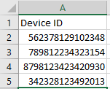
Full File
Frequency to generate file is set as daily/weekly/monthly
File naming format is greylist_full_yyyymmdd.csv
File contain the IMEI of the device that need to be grey listed
Frequency | Remarks
Daily | Full file is generated daily
Weekly | Full file is generated weekly. The start of week can be defined as weekday.
Monthly | Full file is generated monthly.

Slide 6
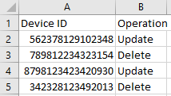
Incremental File
Frequency to generate file is set as daily/weekly/monthly
File naming format is greylist_incrmental_yyyymmdd.csv
File contain two field
IMEI
Operation – Add/Delete. If the number is added in the grey list, operation is set as Add. If the number is deleted, the operation is set as Delete
Frequency | Remarks
Daily | Full file is generated daily
Weekly | Full file is generated weekly. The start of week can be defined as weekday.
Monthly | Full file is generated monthly.

Slide 7
Grey List – Add / Delete Scenarios
IMEI is added in grey list in following scenarios:
Device is marked stolen by lawful agency
Device is requested to be blocked by operator
Device is registered by end user but does not pay tax
Device is found in use in network and is not found in whitelist database
Device is found in use in network but visa has expired.
IMEI is deleted from grey list in following scenarios:
Device is marked recovered by lawful agency
Device is requested to be un-blocked by operator
End User pay tax for registered device
End user upload the visa
End user regularize the device by registering and paying tax for same
Device is moved to black list

Slide 8
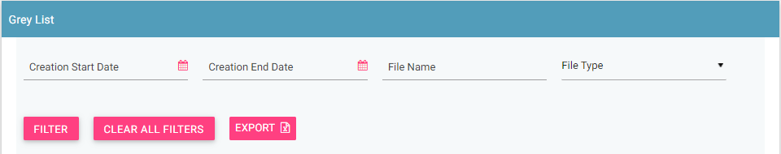
Filter Grey list files
Grey list files can be filtered on the basis of
Date filters, File Name, File type
The user can use a combination of more than one filters to filter the consignments.
Users can view old files using the date filter.
Clear All Filters can be used to clear filters and refresh the data table.
Export button will export the data based on the filters applied.

Slide 9
Sorting of data
By default, the data displayed is sorted in descending order on last modified date.
Data can be sorted based on other fields by clicking the arrow buttons on the column headers. On first click, data will be sorted in ascending order. On second click, it will be sorted in descending order.

Slide 10
Queries

Slide 11
Thank You

